Slide 1
How to Survive Ms.McKenna’s Math Class
Amanda Ng
Muskan Shah
Period 3

Slide 2
Classroom Rules:
Immediately get your Do Now book, sit down at your seat, and begin copying and answering the Do Now questions on the board
Be respectful to your teacher and classmates
Raise your hand, do not call out
Do not talk when a classmate or Ms.McKenna is talking
Pay attention and participate in class discussions and lessons
Quietly exit the classroom when Ms.McKenna dismisses you to, NOT when the bell rings

Slide 3
Homework:
Do the assigned section and questions
Copy down all the questions, and answer each one
Write in pencil on a clean sheet of loose leaf paper
Bring homework to class, do not leave it in your locker
Show all work unless instructed not to
If you have a question, ask Ms.McKenna while she goes over the homework to do it on the board
Take out your homework as Ms.McKenna is checking to see if everyone in your class completed it on time
Do NOT try to finish homework at the beginning of class

Slide 4
Tests or Quizzes:
Studying:
Getting the “A+”:
Bring home your binder and textbook and read over notes, formulas, methods, instructions, etc.
Do a few kinds of each question as practice and check to see if you were correct
Read over the entire question and look for key details and clues
Check over your answers a few times
Keep an eye out for clueless mistakes
Be positive that you got that “A+” when you hand in your paper

Slide 5
Projects:
Make sure you know exactly what to do, if not, ask Ms.McKenna in class before it is too late
Don’t procrastinate and do the project the night before it’s due, begin working on it a week beforehand and finish with a few days to spare
If you don’t know what to do for something, ask a friend what they did; but do not copy them
Be creative and “think outside of the box” to make your project special, unique, and different from everybody else’s

Slide 6
Formulas You Absolutely Need to Know:
Area:
Surface Area:
Rectangle/parallelogram=bh
Triangle=½bh
Trapezoid=½h(b₁+b₂)
Circle= πr ²
Cylinder=2πr ²+2πrh
Rectangular prism= 2(wh+lw+lh)
Triangular prism= bh+2ls+lb OR 2B+Ph
Cone= πr²+πrl
Sphere= 4πr²
Pyramid=B+½Pl

Slide 7
Continued…
Volume:
Other:
Prism=lwh
Cylinder=πr²h
Cone=⅓ πr²h
Pyramid=⅓Ah
Sphere= 4/3πr³
Circumference of a circle=πd OR =2πr
Pythagorean Theorem= a²+b²=c²
Slope intercept form=mx+b
Slope=rise/run Y₂-Y₁
X₂-X₁
Perimeter of a square=4s
Perimeter of a rectangle=2l+2w

Slide 8
Other Important Things You Need to Know:
Reflections: x-axis: (x,-y)
y-axis: (-x, y)
Rotations: 90°: (y,-x)
180°: change signs according to their quadrant
270°: (-y, x)
Translations: up: + y-vaules
down: - y-values
left: - x-values
right: + x-values
To find the total number of interior degrees in a polygon: 180(n-2)
I=Prt

Slide 9
How to do well on the NJASK:
Keep notes from the entire school year to look back at later
Do NJASK packets
If you don't understand something, be sure to ask Ms.McKenna to clarify
Ask Ms.McKenna for worksheets and packets for extra practice
Take home your Do Now book and look over everything
Be aware when you have NJASK and study beforehand
Don't stress too much, just be confident in yourself

Slide 10
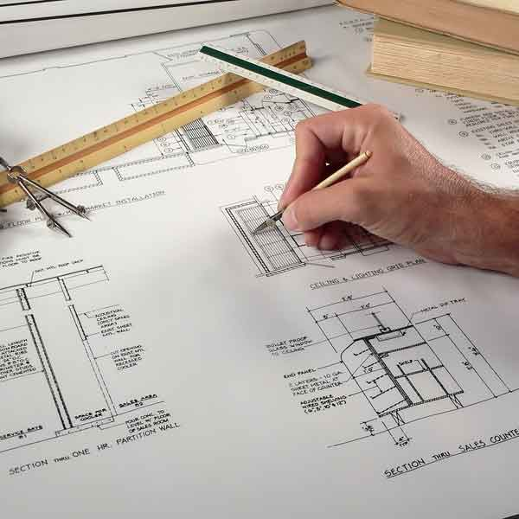
Architects:
One of the many careers that use mathematics is architecture. Architects plan and design buildings and houses. They provide scale models, floor plans, figure out costs, materials, equipment, construction time.
They use math to make a scale drawing/model, create the dimensions of the rooms, windows, doors, etc.
Architecture companies include: Lord, Aeck & Sargent; Leo A Daly; SHH; and Office of Metropolitan Architecture. Some famous architects are Frank Lloyd Wright, Adolf Loos, Aldo Rossia, and Louis Isador Kahn.

Slide 11
Using the Math You Learned in Class:
In math, you’ll learn many useful things for your life.
Percents: You’ll learn how to calculate discounts, interests, and rates
Geometry: If you become an architect, engineer, or construction worker- you’ll need to use geometry
Algebra: You use lots of algebra everyday without knowing, for example:
You want to buy a new game system, and you have $1,000 to spend. The game system costs $600, games costs $40 each. How many games can you buy with the game system?
This is a real life problem, and to find the answer, let x be the number of games.
1,000≥600+40x
The answer would be x=10 games

Slide 12
Just remember:
This isn’t high school, you don’t need to worry about college yet. Just care about getting the best grades that you can and possibly moving up a level for next year.
When you actually get more involved into it, math can be very interesting.
Good luck this school year, and have fun! ☺

