Slide 1
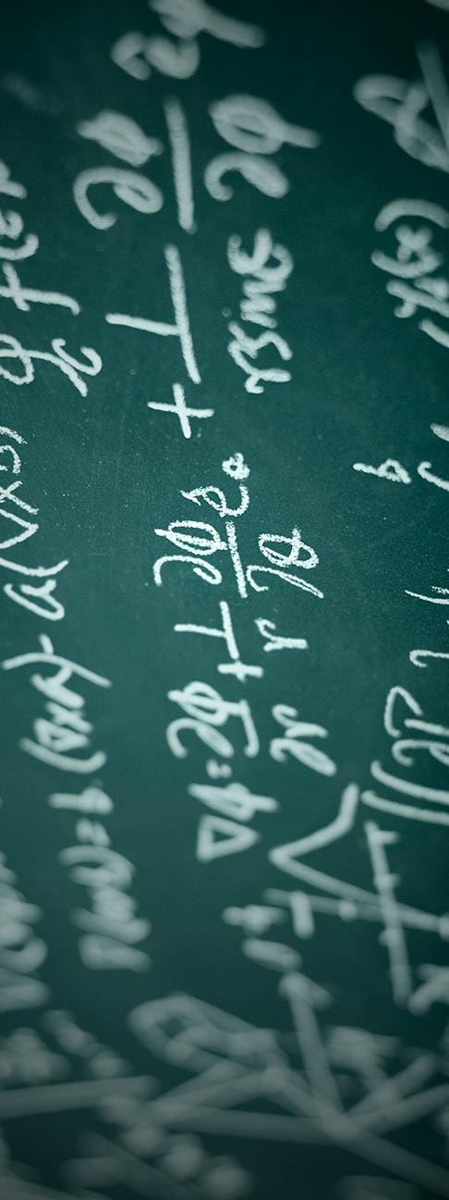
Miss Mckenna’s Math Class
Find out how to survive this crazy course that will prepare you for high school.
By Sanjana Saji & Jen Lazarowitz

Slide 2

Obeying Classroom Rules
It’s really important the way you should present yourself in class.

Slide 3
Just Follow The 5 “P’s”
PROMPT arrive to class on time & get started on the do now
PRODUCTIVE listen to directions, participate, & focus
PREPARED bring supplies: math binder, paper, pencil, textbook
POLITE respect others, raise your hand, and no chewing gum
PASSIONATE study for tests & quizzes, try to achieve goals that is beyond what is given in class

Slide 4

Homework
Refers to tasks assigned to students by their teachers to be completed outside of class.

Slide 5
FACts about HW
Worth 15% of your grade
I point for completion
Usually bookwork or worksheets
½ credit given if brought the next day

Slide 6
Use the math you’ve learned In Real Life

Slide 7
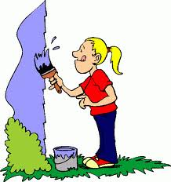
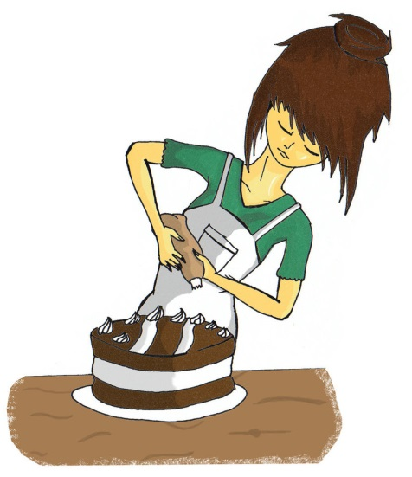
when will I ever use this?
In math you learn a lot of things, some you think you will never need again. But math is everywhere and is used everyday.
For example:
Cooking- Whether its making a cake or serving a salad, measuring the ingredients is a key part of succeeding in the kitchen.
Decorating-. Whether its hanging up a picture frame or painting a room, knowing how to converts units are used during this task.
Shopping- Whether its buying a car or a pack of gum, math is used to find out how much you owe.

Slide 8
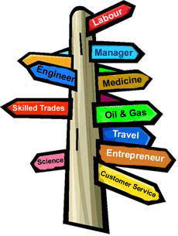
Math Career
Many careers use math daily and that’s why it’s important to keep in touch with your basic skills.

Slide 9
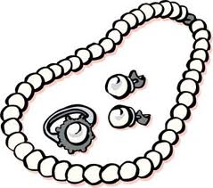

Jewelers
How do jewelers use math?
Ratios/ Proportions- when measuring
Geometry- cutting the stones and diamonds
Basic counting- selling/ buying materials
Symmetry- making sure the jewel is even on all sides

Slide 10

How to Study and Do Well on Tests and Quizzes
Many people stress out before a test or quiz and that may affect your performance but there are a lot of ways you can prevent those feelings.

Slide 11

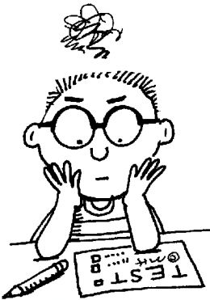
Night Before the Test
You should have most of the lessons covered at this point, not just cramming everything in one night.
Ponder across the topics you have difficulty with and do extra practice problems.
Try to do the questions labeled, “Challenge”, because that’s how you can test your knowledge.
Make your own study guide.
Always do the chapter test in your textbook.

Slide 12

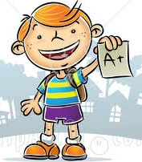
Stay Cool at School
Don’t try to study five minutes before the test, it will just pressurize you even more.
Be ready with at least an extra pencil or lead and an eraser.
Keep a pace, it’s like running on a track. Don’t go too slow but don’t go too fast either.
You have extra time? Take advantage of it. Check over your answers once, twice, thrice!
If you get stuck on a problem for more than 3 minutes, move on.

Slide 13
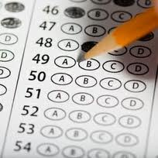
NJASK Prep
A great year will come to an end with a closure of a terrorizing standardized state test. But it’s easy once you have pondered across all the topics.

Slide 14
Simple Skills To Cover
Symbols & Signs be able to identify what symbols represent like in geometry and inequalities.
Formulas
Interior Angles Measure= (n-2)180
Simple Interest: A= P+ Prt
Compound Interest: A = P(1 + r)t
Pythagorean Theorem: c2 = a2 + b2
Basics know your basic equations before solving any complicated problems.
Know perimeter & area before surface area
Know how to solve multistep equations before solving equations with variables on both sides

Slide 15

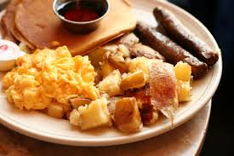
Right Before Testing:
Eat a good breakfast even if you usually don’t.
Don’t study last minute (this applies to everything.)
Start timing yourself by doing practice tests a month before.
Keep calm and carry on.

Slide 16
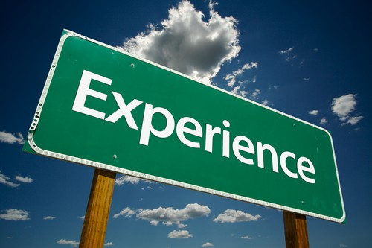
Our Experience
A whole school year has come to an end and we have something to say about it.

Slide 17

Sanjana’s Journey
Mrs.McKenna is an excellent teacher. She’s really nice (unless you aggravate her) and she’s young so it’s easy to relate to her. I have learned a lot this year and I love coming to this class because it’s a fun environment to learn in.

Slide 18

Jen’s Journey
I learned a lot in this class. Miss McKenna is a great teacher and knows how to explain things in many different ways. She is very patient and a joy to have as a teacher.
P.S.- I, Jennifer Lazarowitz always will be Miss McKenna's favorite.

Slide 19
THE END
Thanks for watching.

