Slide 1
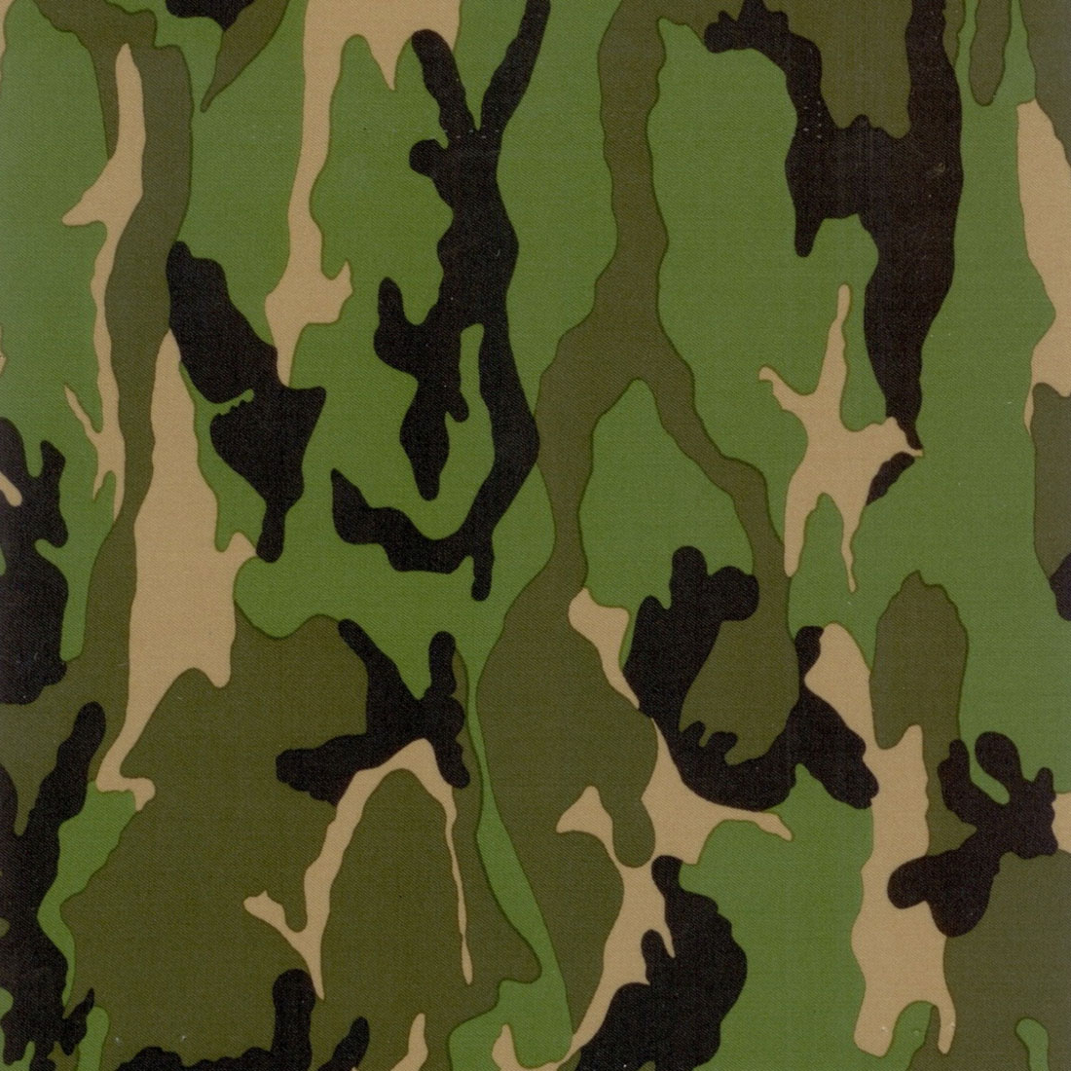
Surviving
Miss McKenna's math
class
All the tips you need to survive 8th grade pre-algebra
Kelley Gosling - 2013
$$a^{2}+b^{2}=c^{2}$$

Slide 2
Obeying Classroom Rules:
Be respectful.
Be attentive.
Be timely.
Be responsible.
Be prepared.
Be polite.
Try you best! ☺ (I’m going to say that a lot during this PowerPoint because I cannot stress that enough.)

Slide 3
Getting Full Credit on Homework:
(for some, its harder then you think)
Show All your work.
Keep your work organized and legible. (I like to highlight my final answer.)
Attempt every problem. (even if you know you got it wrong.)
Corny joke Worksheets are the best! ☺

Slide 4
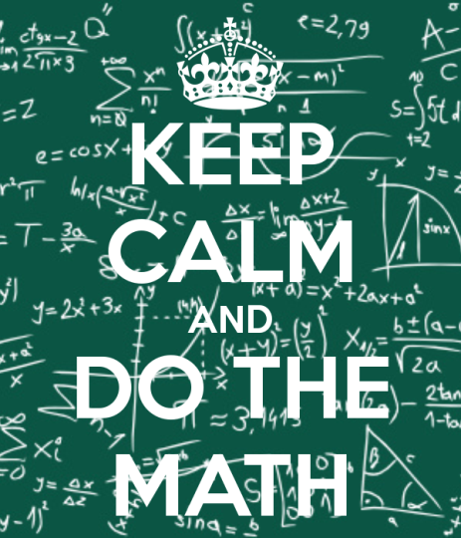
Doing well on tests/quizzes/projects:
Show all your work!!!!!
Read all directions!!!!!
Study!!! (I’ll explain how next slide)
Check your answers! (you will make silly little mistakes)
Check, double check, then check again that you have followed all directions and/or have met all project requirements.

Slide 5
Studying for a test/quiz:
Miss McKenna tells youin advance when a test/quiz is.
Don’t study all in one night – start about three days beforehand.
Review notes and review sheets. (you’ll get one for every test/Quiz)
When the book has a quiz section is when you will have a quiz, so plan ahead.
I suggest doing problems from the book.

Slide 6
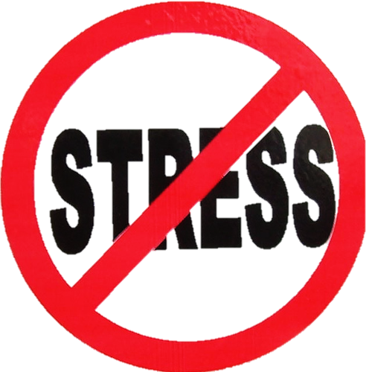
Preparing for the NJ ask:
(Personally, I seriously think people get way over stressed over the NJ ask)
miss McKenna does an awesome job preparing you.
Do well on open-endeds (I love open-endeds)
Use your reference sheet!!!!!
Study basic formulas. (I’ll tell you which in a few slides.)
Read over your notes starting a week before the test – not the day before!!!!!
Relax, breathe and try your best! ☺

Slide 7
Actually using what you learned:
(Yeah. It will happen)
Shopping (if you actually like doing that)
Pay checks
Taxes (ugh!)
Tips
Budgeting
Cooking/baking
Bills (also, ugh!)
Interest on bank accounts
Mortgage/rent
Investments

Slide 8
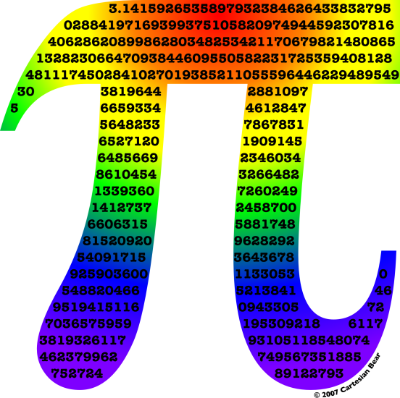
Important formulas :
A = bh
V = lwh
SA = 2lw + 2wh + 2hl
I = prt
y = mx +b
A² + b² = c²
A = 2πr
C = πd
& more . . .
Your Reference sheet is your new best friend!!!!!

Slide 9
Career with math:
Chef!!!
Chefs are responsible for:
controlling the kitchen
Preparing different dishes
Time managing meals
Consistency in food
How is this related to math?
measuring ingredients.
Revising recipe amounts to produce the appropriate amount of servings.

Slide 10
Other tips from me ☺ :
(Just cause I have a lot of them.)
keep your binder organized!!!!!
DO your homework (they are an easy 100)
Don’t complain – you’ll just get more HW.
Study for tests/quizzes – it helps.
Sit by the windows if you happen to have gym before math like I did.
Always try your 110% absolute best!!!
Miss McKenna is awesome & amazing & every other positive-cognotationed adjective

Slide 11
Good Luck ☺
(especially if you have gym before math. . .)
&
May the odds be your favor
(get it? Odds are math. Lol. )
Kelley Gosling class of 2013

