Slide 1
How To
Survive Miss McKenna's Math Class

Slide 2
Introduction
Welcome to a How To survive Miss McKenna math class. Here you will learn how to -
Obey Classroom rules
Get full credit on your homework assignments
Study for a test/quiz
Do well on those tests/quizzes/projects
Prepare for the NJASK
Use the math you've learned
Most importantly - How NOT to be like Zach or Nikhil

Slide 3
How To - Obey Rules
Following the RULES is NOT that hard.
There are three simple rules you must follow -
-Hands to yourself
-Be quiet
-Listen to the teacher

Slide 4
What not to do!!!
Talk when the teacher is talking
Chew gum
Annoy Ms. McKanna
Don't be like Zach and Nikhil

Slide 5
How To - Get Full Credit
Getting full credit for your homework is simple.
HAND IN THE HOMEWORK ON TIME
SHOW ALL WORK

Slide 6
What not to do!!!
Being lazy to do your homework. It's not that hard to do
Do it last minute. She collects it
Forget your homework at home
Don't be like Zach or Nikhil

Slide 7
How To - Study For A Quiz
Interesting tips to help you study
1.)Don't wait until you feel interested or entertained by your study.
This will only make you lose focus and attention to study and will only delay the time you have left to study.
2.) Study THAN relax.
You need to absorb, assimilate, and digest the information to make it your own. By relaxing you are absorbing that information.

Slide 8
What not to do!!!
Study in Homeroom. You won't be able to understand anything
Not study at all
Stress out
Don't be like Zach or Nikhil

Slide 9
Motivation

Slide 10
What not to do!!!
Give up
Don't be like Zach and Nikhil

Slide 11
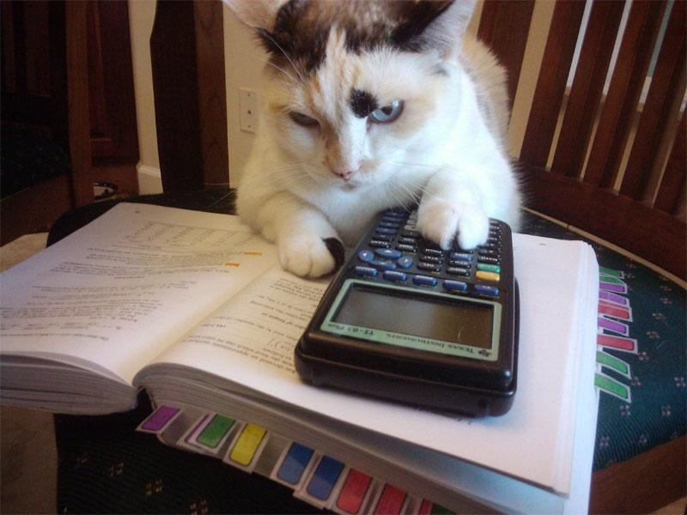
How To - Do Well On Assignments
For Tests And Quizzes
S - T - U - D - Y LIKE A BOSS
For Projects
There are different elements that make up a good project
Purpose and Relevance, Time, Complexity, Intensity, Connected, Access, Shareable, Novelty.
Just remember to stay on task and to follow the instructions.

Slide 12
What not to do!!!
Goof off playing videogames such as Saints row the third or TF2
Don't care about till last minute where you rush through it and end up getting an F and you cry wishing you done your work and now you're a clown at a 8 year olds birthday party
Don't be like Zach or Nikhil

Slide 13
Prepare For NJASK
Yet Again...
STUDY WITH EVEN MORE MOTIVATION

Slide 14
What not to do!!!
Again...
Give up
Don't be like Zach and Nikhil

Slide 15
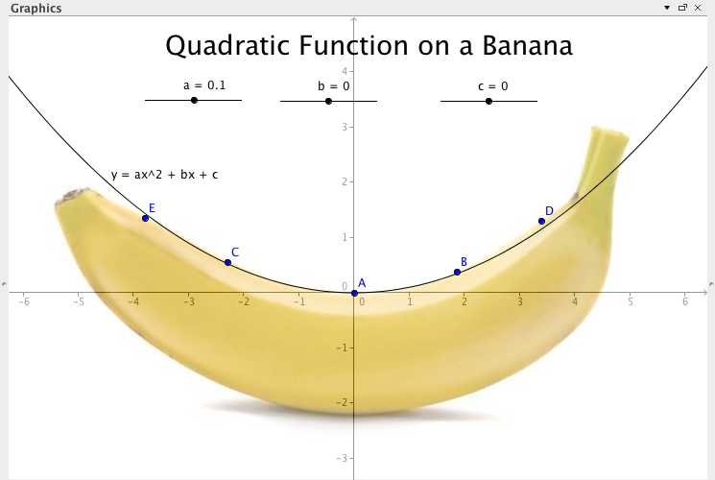
Using The Math You've Learned
Paying for the Man's taxes
To solve financial problems
Commute
Discounts
Saving
Cooking
Correct Change
Following Distance

Slide 16
What not to do!!!
Forget how to do math
Never ever EVER!!! Forget how to do the pythagorean theorem because when you grow up, you will need to know this or you can't live.
Don't be like Zach or Nikhil in the future

Slide 17
Important Math Facts, Formulas, and Theories
Income Tax
Solving Multi Step Equations
Probability
Surface Area
Theoretical Probability

Slide 18
Experience In Math Class
While having a ton of fun in class we were always the type of students that were -
Always paying "attention"
Always "participating"
And were always "good students" in class

Slide 19
Careers That Use Math
Accountants and auditors
Aircraft pilots and flight engineers
Computer programmers
Cost estimators
Dentists
Drafters
Electrical and electronic technicians
Engineering technicians
Financial managers
Insurance sales workers
Landscape architects
Management analysts and consultants
Optometrists
Pharmacists
Physicians
Psychologists
Real estate agents and brokers
Science technicians
Securities and financial services sales workers
Sociologists
Surveyors
Tool programmers, numerical control
Underwriters
Urban and regional planners
Veterinarians

Slide 20
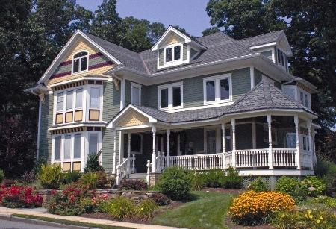
Architect
What an Architect does
The architect is a trained professional who is central to the development of both the planning and the design components that form the basis for the construction of a building. Here is some background on how an architect works, and why the utilization of a competent architect is so important to any building project.
Architecture Companies
Mileto - Godsall Associates LLC.
Foster + Partners

Slide 21
A song that represents us
Bad to the bone
Bad to the bone
B-B-B-B-Bad
B-B-B-B-Bad
B-B-B-B-Bad
Bad to the bone

