Slide 1
How to Survive Miss McKenna's Math Class
By: Rhea Kanwar And Annum Faheem

Slide 2
Classroom Rules
Be Prompt
Arrive to class on time
Start working on the Do Now immediately
If you are late, make sure to have a pass
Be Productive
Always give your undivided attention, and listen entirely
Participate in class discussions
Remain focused on your work till the teacher dismisses you
Be Prepared
You are required to bring to class everyday...
Math binder
Loose leaf paper

Slide 3
2 pencils
Your homework
Covered math textbook
Be Polite
Respect yourself, classmates, and teacher
Raise your hand, don’t yell across the room
Do not speak when others are speaking
Keep object and inappropriate language to yourself
Chewing gum or eating is prohibited
Never leave the room without a pass

Slide 4
Failure To Comply With The Expectations Will Receive
1. Warning issued by teacher
2. Parent phone call/ referral to guidance counselor
3. Morning or after-school teacher detention
4. Written referral to administration
Preparation
You must bring these items to class everyday
Three Ring Binder
Loose Leaf Paper
Marble Notebook
Two Dividers
Pencils
A Colored Pen

Slide 5
Homework Assignments
Value
Homework/Participation/Classwork is 15% of your grade
Each homework assignment is worth 1 pt
Full Credit
Full Heading
Attempt all problems
Shows all work
Show All steps
Done in PENCIL
Copy the questions (if Ms. McKenna says)
Attempt all questions!
If you do not have homework the day it is due, you may bring it in the next day for ½ credit.
If you are absent it is your responsibility to obtain any missing assignments and hand in the due homework

Slide 6
Test /Quizzes/Projects
Value
Quizzes are 35% of your grade (40-60 pts each)
Test/Projects are 50% of your grade (100 points for each)
Study for a Test/Quiz
Review the lesson notes from class, and the textbook
Look over your homework, and classwork
Do practice problems, and attempt the study guide in the textbook
Examine the review sheet (if one is given), and make sure you understand everything on it
Ask Ms. McKenna or another student if you have questions concerning the quiz/test
Stop by and ask Ms. McKenna for extra help if you are struggling to keep up in class, or don’t understand the material

Slide 7
Do Well on Test/Quizzes
Study the material being tested, and make sure you understand it completely
Follow the directions completely
Show all your work
Make sure your handwriting is neat and legible
Label your answer if necessary
Make sure to go at a swift paste, and finish each question
Focus on the test completely, not your classmates
Try your best!
Do Well on Projects
Follow the directions, and instructions
Complete all the requirements
Be Creative
Make sure to hand it in on time
Check it when completed

Slide 8
Incorporating the Skills That We Have Learned
Standardized Test
In order to excel on standardized tests you are required to use math skills, and knowledge. The following test that you will be taking eventually involve math.
Njask
SAT
GED
Careers
In order to get into any occupational field that requires you to receive a higher education you must use math.
Computer Science
Engineering
Medicine
Commerce Analyst
Electronics
Scientist

Slide 9
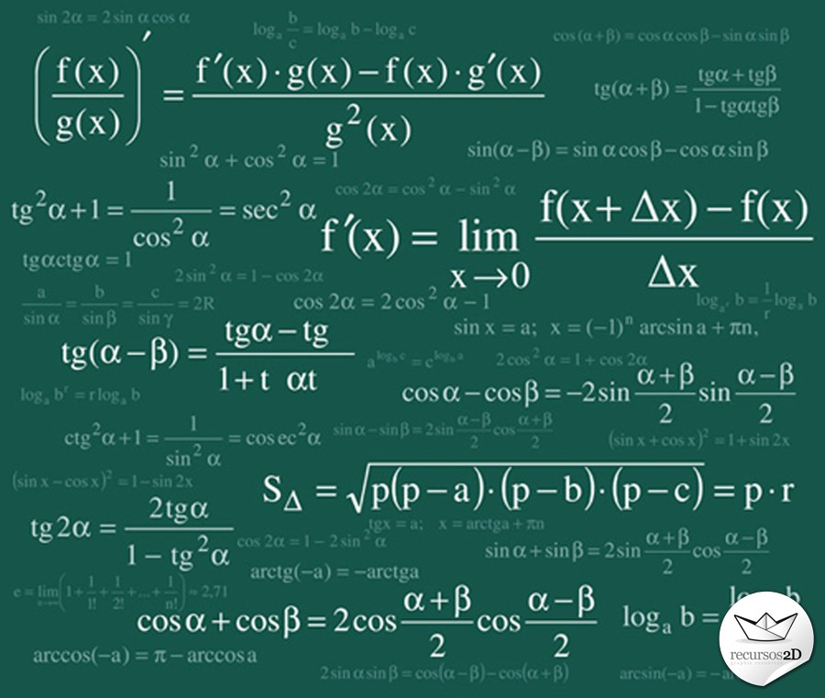
Formulas

Slide 10
Equivalents
60 seconds = 1 minutes
60 minutes = 1 hour
24 hours = 1 day
12 months = 1 year
365 days = 1 year
12 inches = 1 foot
3 feet = 1 yard
36 inches = 1 yard
5,280 = 1 mile
1000 meters = 1 kilometer
10 decimeter = 1 meter
7 days = 1 week
100 centimeters = 1 meter
10 millimeters = 1 centimeter

Slide 11
8 fluid ounces = 1 cup
2 cups = 1 pint
4 quarts = 1 gallon
16 ounces = 1 pound
2,000 pounds = 1 ton
1000 milligrams = 1 gram
100 centigrams = 1 gram
10 grams = 1 dekagram
1000 grams = 1 kilogram

Slide 12
Circumference/Perimeter
Circumference
Circle
2πr or πd
Perimeter
All Shapes
Add all the sides
Rectangle
2l + 2w

Slide 13
Area
Triangle
1/2bh
Parallelogram
bh
Trapezoid
1/2H(B₁+ B₂)
Circle
πr² or πd

Slide 14
Volume
Sphere
4/3πr³
Cylinder
πr²h
Cone
1/3πr²h
Rectangular Prism
lwh
Pyramid
1/3lwh

Slide 15
Surface Area
Rectangular Prism
2lw+2wh+2lh
Sphere
4πr²
Cylinder
2πrh+ 2πr²

Slide 16
Prepare for Njask
The Njask consist of three types of questions multiple choice questions, short constructed responses, and open ended responses. Here are some tips to prepare your for this standardized test, and get you familiar with the question types.
Multiple Choice Questions
Read the entire question, and focus on the key words such as “not” or “only”
Try to answer the question without the choices, and see if you receive one of the choices
Use process of elimination, and try to take out the wrong choices
If you are stuck between two choices then take an educated guess, and choose your first answer
Make sure you fill in the bubble dark, and completely

Slide 17
Short Constructed Response Questions
Read the entire question, and look for key words
Solve the problem, making sure you show all your work
After you have the correct answer neatly write the answer
Open Ended Response Questions
Read the entire question, and look for key words
Began to solve the problem, making sure you show all your work
After you have the correct answer, explain your work, and steps
May sure your work neat and legible
Refer Back To Ms. McKenna’s Njask Review Work
Do Now Questions- The questions we answer daily in the beginning of class helps to give practice in multiple choice questions
Math Packets- Complete all the math packets Ms. McKenna gives you because it will help you get prepared
Math Formulas
Notes

Slide 18
Math Facts
An equation has to have an equal sign
The Pythagorean Theorem was first known to Chinese and the Babylonians
Math is used in everyday activities, whether it’s trying to play a game of soccer with your friends or even just the grocery shopping
Most of the development of the subject of math gradually increased during the Medieval Age
In the world East of Greece, math was primarily used as a practical science to assist in agriculture, engineering, and business pursuits

Slide 19
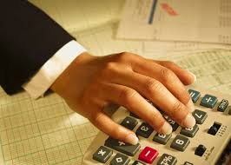
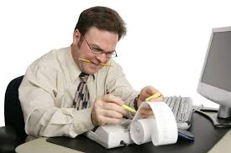
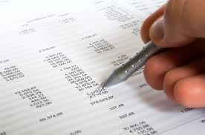
Accountant

Slide 20
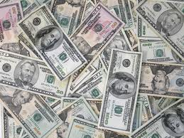
Accountant
An accountant is an individual who performs accounting tasks for individuals or companies. The exact material that an accountant handles varies depending on the size of the company and the accountant's specialization, but generally includes financial records, taxes, and responsibility for the issuing of financial reports. An accountant is one of the primary figures in a business that he or she works for, whether it is a multinational corporation or a small family owned business. Requirements to become an accountant vary upon specialization and nation, but generally include certification through a professional agency and a basic college degree in accounting and finance.

Slide 21
Hope You Survive!

